Slide 1
The Cyberspace and Cybersecurity
Introduction to Cybersecurity

Slide 2
The Cyberspace 1: Where it all began

Slide 3
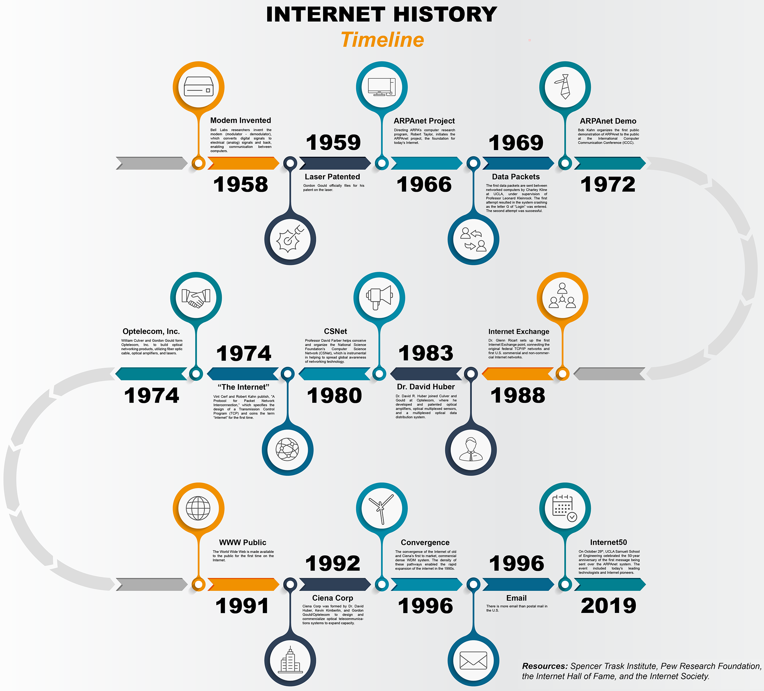
The Cyberspace 1: Where it all began
"Necessity… the Mother of Invention…"

Slide 4
The Cyberspace 1: Where it all began
• In 1969 the first Wide Area Network (ARPANET) was a product of the US Military research centers' (DARPA) need for need for communication even in the event of a nuclear attack from the Soviet Union (now Russia). The first data sent was "LOL"
• In 1971, Ray Tomilson coded the means for the users of the ARPANET to be able to identify themselves, termed email. This displays as [user]@[computer]
• In 1973, the ARPANET made it's first intercontinental integration, moving from an intranet to an extranet

Slide 5
The Cyberspace 1: Where it all began
January 1, 1983 the ARPANET adopted the TCP/IP which enabled a uniform network communication system, even other large intranets adopted this, making extranets the internet. The IP address was adopted for identifying systems on the network.
• Elizabeth Feinler and her team created the format for web addresses, determining that top domain address (i.e. ".com", ".gov", ".net" etc) documented in "HOST.txt". They created the host naming registry and WHOIS protocol.
• Paul Mockapetris, made the Host naming registry's accessing and managing more automated and easier by introducing the Domain Naming System.

Slide 6
The Cyberspace 1: Where it all began
• In 1989, Tim Berners-Lee coded a system which made accessing information on the internet easier by displaying them on a web-page that didn't require the usual logging into terminals, also the information displayed was organized. This was called the world wide web.
• The internet became accessible to all and by 1993 applications to access them called web-browsers were made.
• Company used the internet as a business avenue in 2000.
• In 2004-2005 the internet became interactive with the invention of Facebook ushering in web 2.0 .

Slide 7
The Cyberspace 1: Where it all began
• In 2007 smart phones where introduced making the internet accessible from mobile applications.
• In 2010 the internet of things starting going traction making other devices to connect to the network.
• In 2014, the concept of Web3 was introduced by Ethereum co-founder Gavin Wood
• Now all forms of activities can be done via the internet, and it can be accessed from any location.

Slide 8
Cyberspace 2: The other side of the coin

Slide 9
Cyberspace 2: The other side of the coin
• From just signing-up on a website, you now get an online identity. Services online are accessible only based on these identities,
• To fully benefit from this services we tend to tie more of our physical identifiers to our digital identities.
• To enjoy these services we unknowingly unveil much of our physical identifiers online.
• Now, so much sensitive information is online.
• The "bad guy" now have clear target (we users and the service providers) to get this sensitive information from.

Slide 10
Cyberspace 2: The other side of the coin
• They now search for means to get hijack our identities to gain access to these sensitive information. This sensitive information differ for individuals, organizations and the government.
• Example including our physical address, names, age, debit/credit card details, login details, company intellectual properties, accounts details, business plans, government secret intelligence, etc

Slide 11
Cybersecurity: The Guardian of the Cyberspace

Slide 12
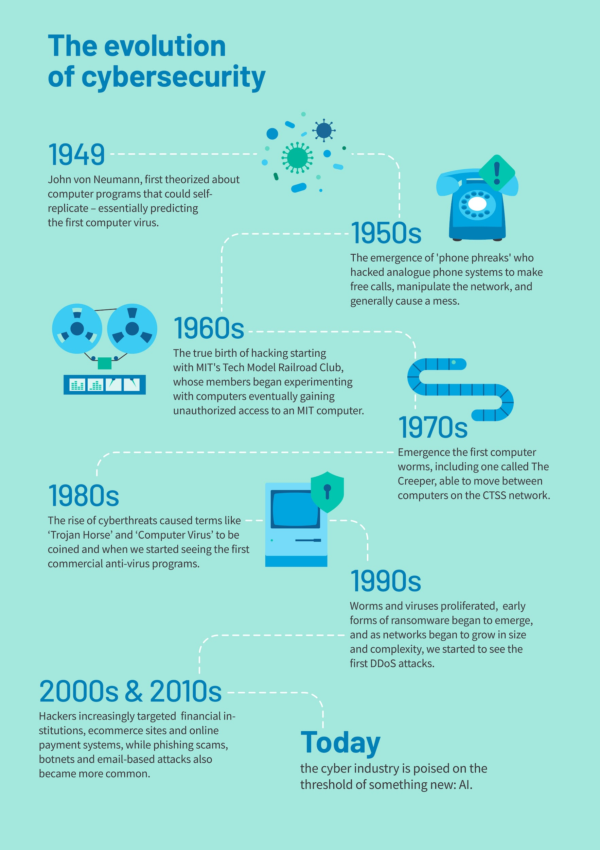
Cybersecurity: The Guardian of the Cyberspace
Cybersecurity is the practice of protecting systems, networks, and programs from digital attacks, maintaining their confidentiality, integrity and availability.
Computer devices have existed right before the internet and their flaws also existed with them too. The history of Cybersecurity can be traced to back then.
Historical Timeline:
https://blog.avast.com/history-of-cybersecurity-avast

Slide 13
Cyberwar: What is the Color of your Hat?

Slide 14
Cyberwar
The Cyberspace has experienced escalating sophistication and frequency of cyberattacks for individuals, organizations and national bodies that vie for digital dominance. This has incited a cyberwarfare.
The paticipant of this war canbe identified by the color of hat they wear.
Generally there 3 basic type of hats to wear.
The “White hat”
The “Gray hat”
The “Black hat”

Slide 15
Cyberwar
THE “WHITE HAT”
“White hats” or White hats hackers, also known as ethical security hackers, identify and fix vulnerabilities. Hacking into systems with the permission of the organizations they hack into, white hat hackers try to uncover system weaknesses in order to fix them and help strengthen overall internet security.

Slide 16
Cyberwar
THE “GRAY HATS”
Gray hat hackers may not have the criminal or malicious intent of a black hat hacker, but they also don’t have the prior knowledge or consent of those whose systems they hack into. Nevertheless, when gray hat hackers uncover weaknesses such as zero-day vulnerabilities, they report them rather than fully exploiting them. But gray hat hackers may demand payment in exchange for providing full details of what they uncovered.

Slide 17
Cyberwar
THE “BLACK HAT”
Black hat hackers are cybercriminals that illegally crack systems with malicious intent. Seeking to gain unauthorized access to computer systems is the definition of black hat hacking. Once a black hat hacker finds a security vulnerability, they try to exploit it, often by implanting a virus or other type of malware such as a trojan.
Ransomware attacks are another favored ploy that black hat hackers use to extort financial gains or breach data systems.
Black hat hackers are also referred to as malicious hackers, unethical hackers, and crackers.

Slide 18
Cyberwar
There are participants at different levels in this war,they are
Blue hat hackers
Purple hat hackers
Red hat hackers
Green hat hackers
Hacktivists
Script kiddies
Whistleblowers etc
More info:
https://www.avast.com/c-hacker-types
https://blog.rsisecurity.com/different-types-of-hacker-hat-colors-explained/

